Slide 1
Loan Qualification

Slide 2

Agenda
Introduction
Data Summary
2.1 Data Source
2.2 Data processing
2.3 Visualization & EDA
Models and Results
3.1 Logistic Regression
3.2 Decision Tree
3.3 Random Forest
3.4 Neural network
3.5 GBDT
3.6 XGBoosting
3.7 Light GBoosting (bonus)
Conclusion
4.1 Summary of the models
4.2 Limitation
4.3 Future Work

Slide 3
Introduction
Why Loan important?
Home Ownership: Mortgages make it possible for individuals to buy homes without full upfront payment.
Education and Career Advancement: Student loans provide access to higher education and better job opportunities.
Essential Purchases: Auto loans and personal loans enable significant purchases that improve quality of life.
Startup and Expansion Capital: Loans provide the necessary funds for entrepreneurs to start and grow businesses.
Our goal
Analyze the results of a loan application using a model to determine which variables are most influential.
Providing loan providers with an efficient tool for making loan decisions.
Analyze the effectiveness of different models and determine which is most suitable.

Slide 4
2. Data Summary and EDA

Slide 5
Data Source
Loan Approval Prediction Playground Series - Season 4, Episode 10
Dataset: credit_risk_dataset.csv
Content: Includes variables related to the loan application, such as loan amount, loan term, and credit history status.
Purpose: Evaluate the impact of financial variables on the likelihood of loan approval.

Slide 6
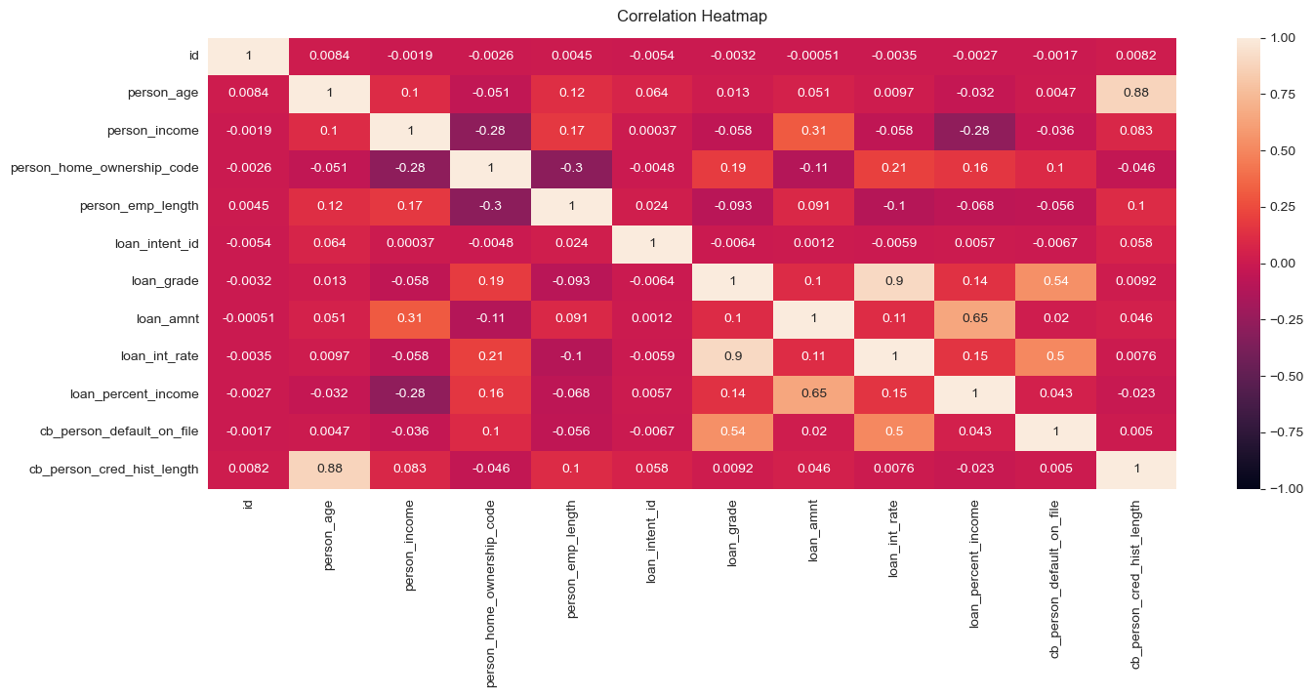

Slide 7
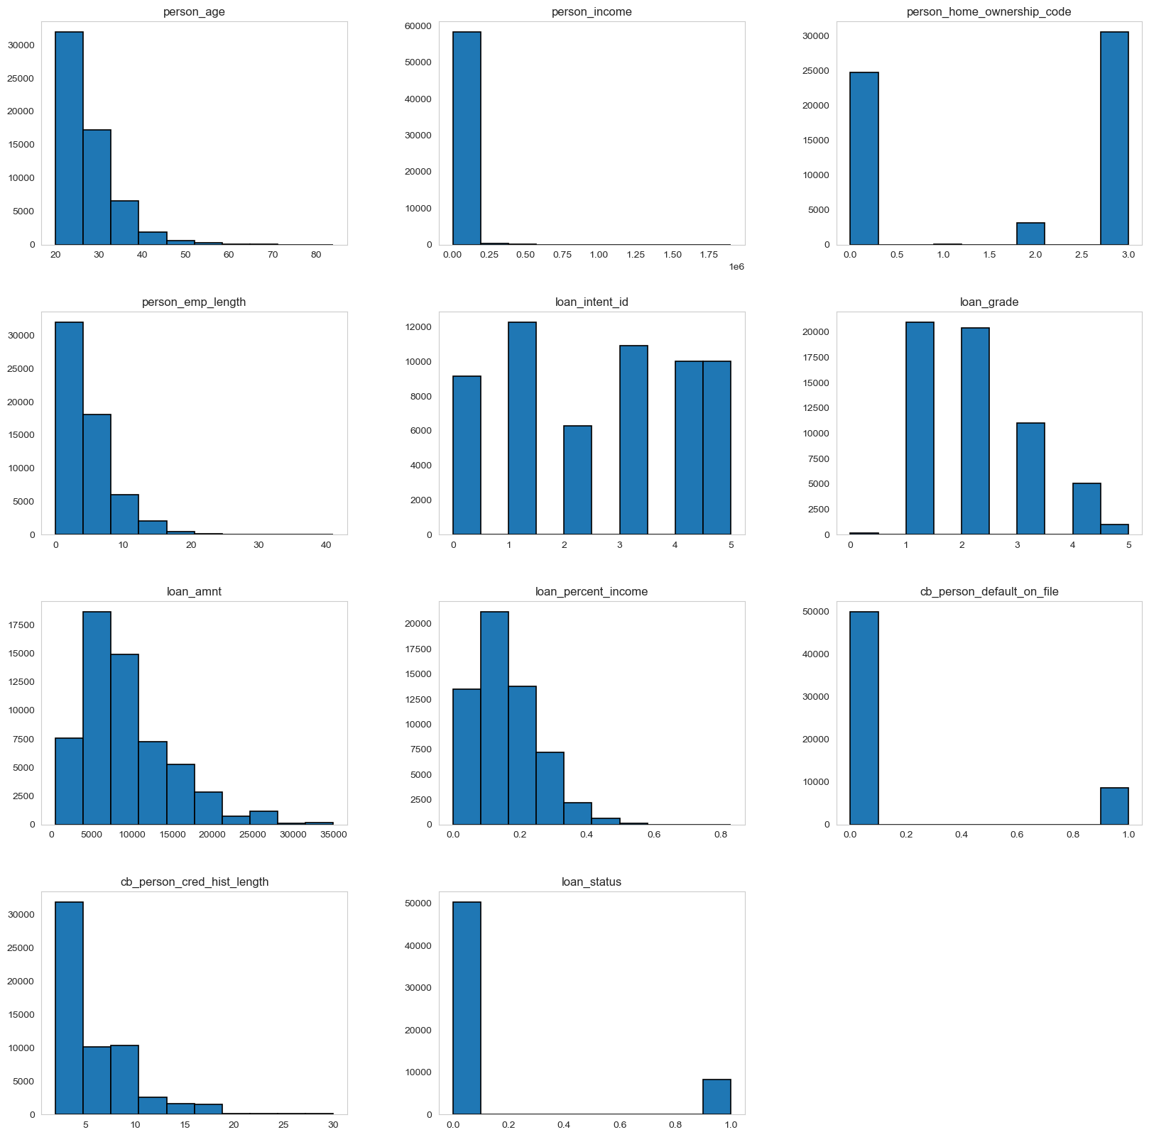
Hist of all variables(ppt only)

Slide 8
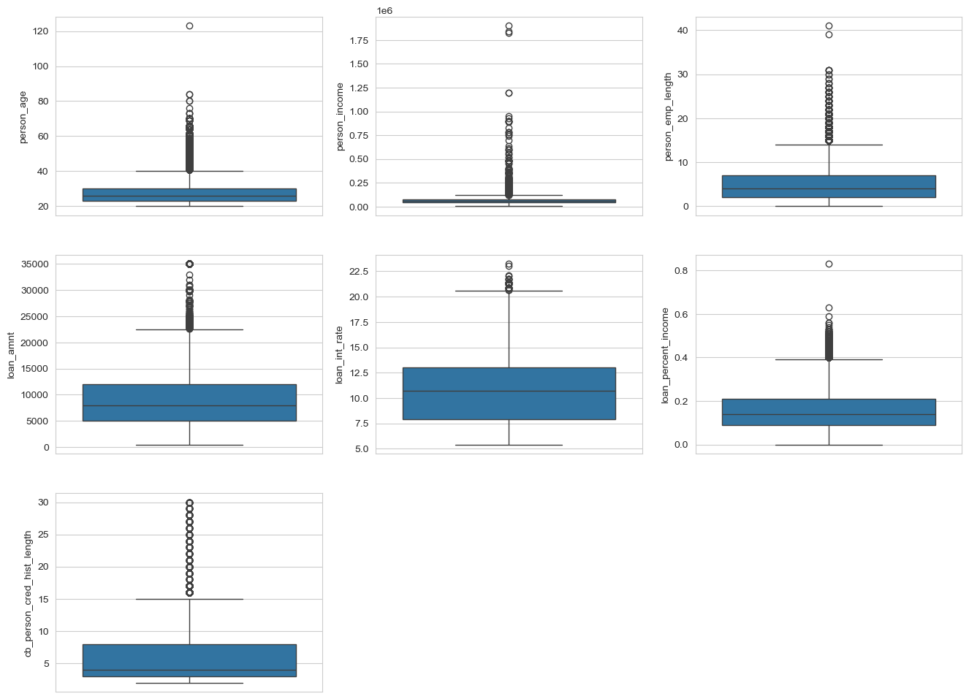

Slide 9
Data Preparation and Preprocessing
● No missing values so deletion of columns and data imputation unnecessary
● keep the applicants start work after 14 years old
● Edit 4 variables from categorical to integer values
{person_home_ownership, loan_intent, cb_person_default_on_file, loan_grade}
● drop the data with applicant age greater than 100
● Drop the column of loan_int_rate as the correlation to loan_grade is too high
(Shows in correlation heat map in 2.3)

Slide 10
3. Models and Results

Slide 11
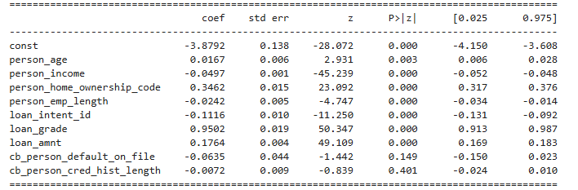
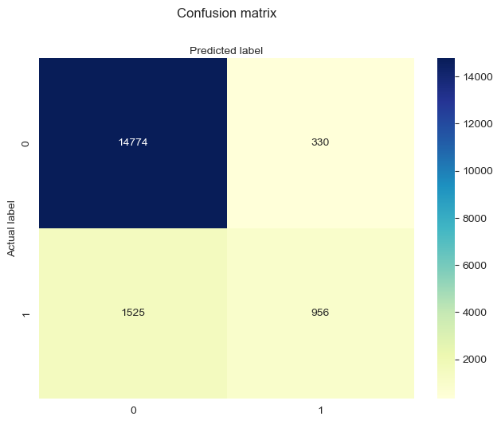
Logistic Regression
The logistic regression model achieved 89.12% accuracy, excelling at predicting rejected loans but struggling with approved loans.
Key drivers of approval include loan grade (strong positive) and loan amount, while person income negatively impacts approval odds, requiring further investigation.
Insignificant variables like credit history length could be reconsidered. Improvements, such as adjusting thresholds or balancing classes, are needed to better identify eligible applicants and improve recall.

Slide 12
Decision Tree
Accuracy train data: 94.26%
Accuracy predict: 93.86%
Precision: 86.73%
Recall: 66.67%
F1_score: 75.39%

Slide 13
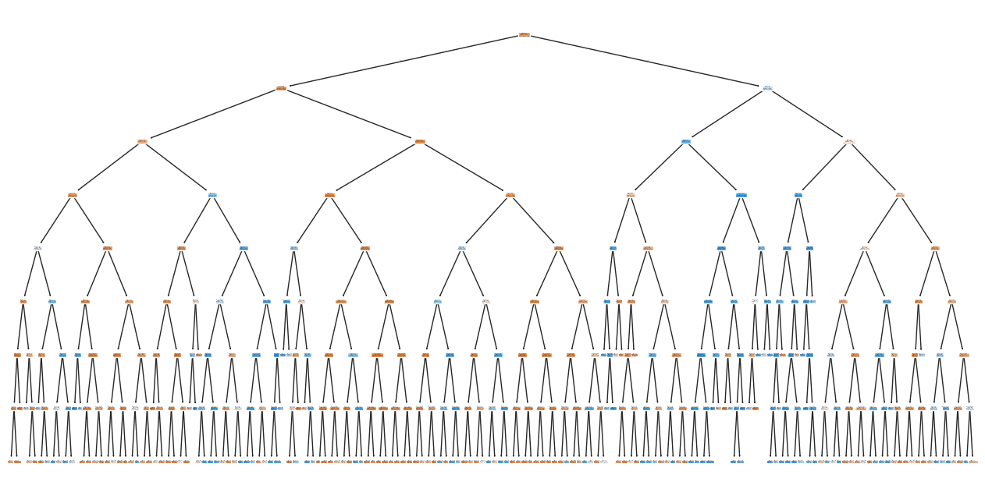
decision tree result

Slide 14
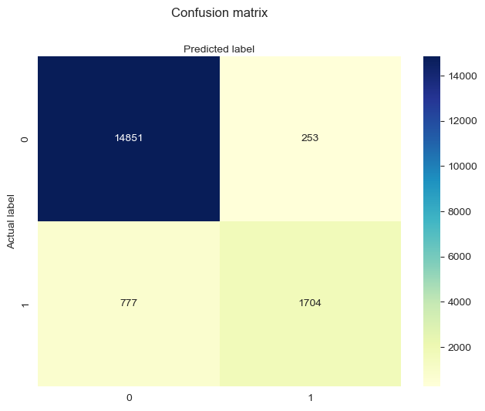
Confusion matrix
The model performs well overall, with high accuracy and specificity, making it reliable for identifying rejected loans.
Precision is strong, meaning most predicted approvals are correct.
Recall for approvals is moderate (68.7%), indicating some eligible applicants are missed.
Improvements can focus on enhancing recall for approved cases (e.g., adjusting thresholds or rebalancing classes).

Slide 15
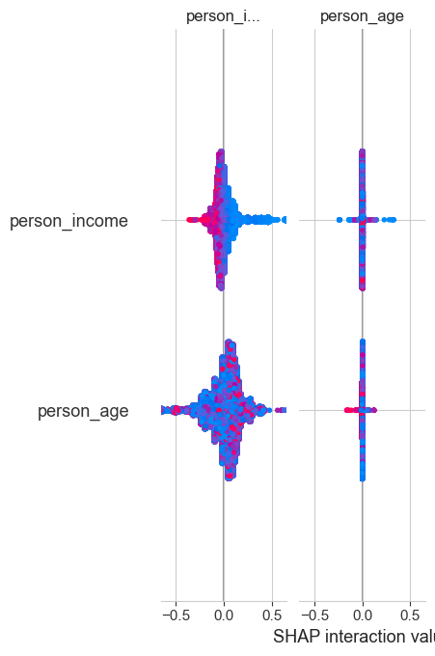

SHAP*
The SHAP interaction plots show how person_income and person_age individually and together influence the decision tree model's predictions.
Both features have significant individual impacts, with person_age showing a wider effect range, while their interaction is minimal in most cases.
Outliers in the data suggest certain age-income combinations disproportionately affect predictions, highlighting specific edge cases.

Slide 16
Random Forest
Model Overview
Accuracy train data: 92.67%
Accuracy predict: 93.09%
Precision: 91.58%
Recall: 56.15%
F1_score: 69.62%

Slide 17

The model achieves strong performance, characterized by high accuracy and specificity, making it reliable for correctly identifying non-default cases.
Precision is solid, indicating that most loans predicted as defaults are indeed defaults, ensuring minimal false alarms.
However, the recall for defaulted loans is moderate (56.1%), suggesting that some default cases are not identified by the model.
Enhancements could focus on improving recall for default loans by adjusting decision thresholds, balancing the dataset, or incorporating additional predictive features.

Slide 18
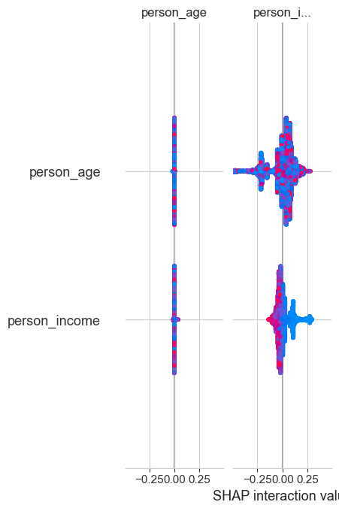
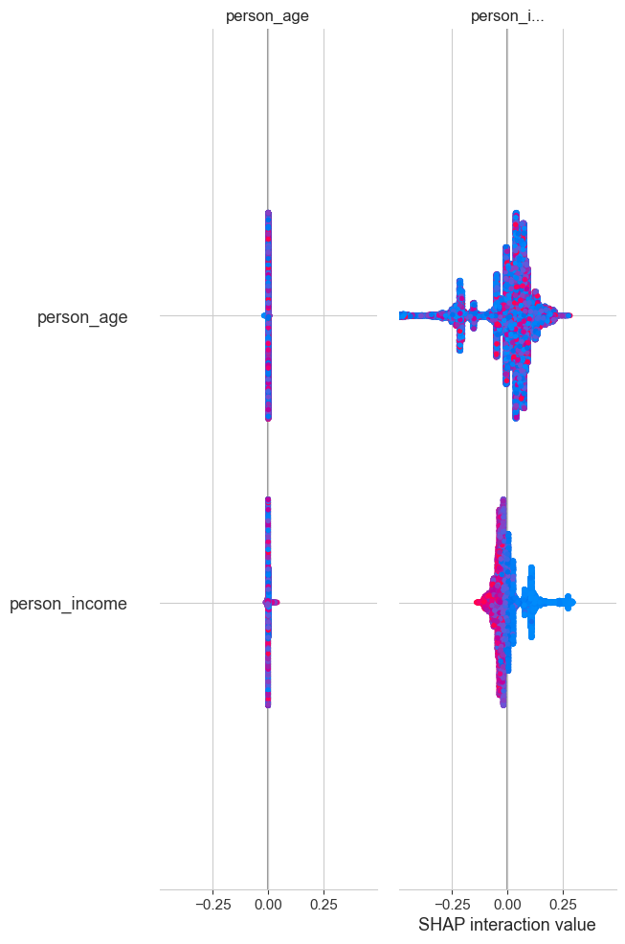
SHAP
The SHAP interaction plots illustrate how person_income and person_age independently and jointly contribute to the Random Forest model's predictions.
person_income has a dominant individual impact, significantly driving predictions, while person_age demonstrates a relatively smaller but consistent influence. Their interaction effect is minimal, indicating that income primarily dictates prediction outcomes.
Outliers in the SHAP values suggest unique combinations of age and income that deviate from typical trends, revealing potential areas for further investigation or model refinement.

Slide 19
Neural Network
Accuracy train data: 94.32%
Accuracy predict: 94.54%
Precision: 90.99%
Recall: 68.00%
F1_score: 77.83%

Slide 20
Neural Network structure
Input Layer:
Accepts input of dimension X_train.shape[1].
Hidden Layers:
Dense layers with decreasing units (128, 64, 32) for hierarchical feature extraction.
ReLU activation for non-linearity.
BatchNormalization for stable learning.
Dropout for regularization (40%).
Output Layer:
Single unit with Sigmoid activation for binary classification.
Regularization
L2 regularization (λ = 0.01) to prevent overfitting.

Slide 21
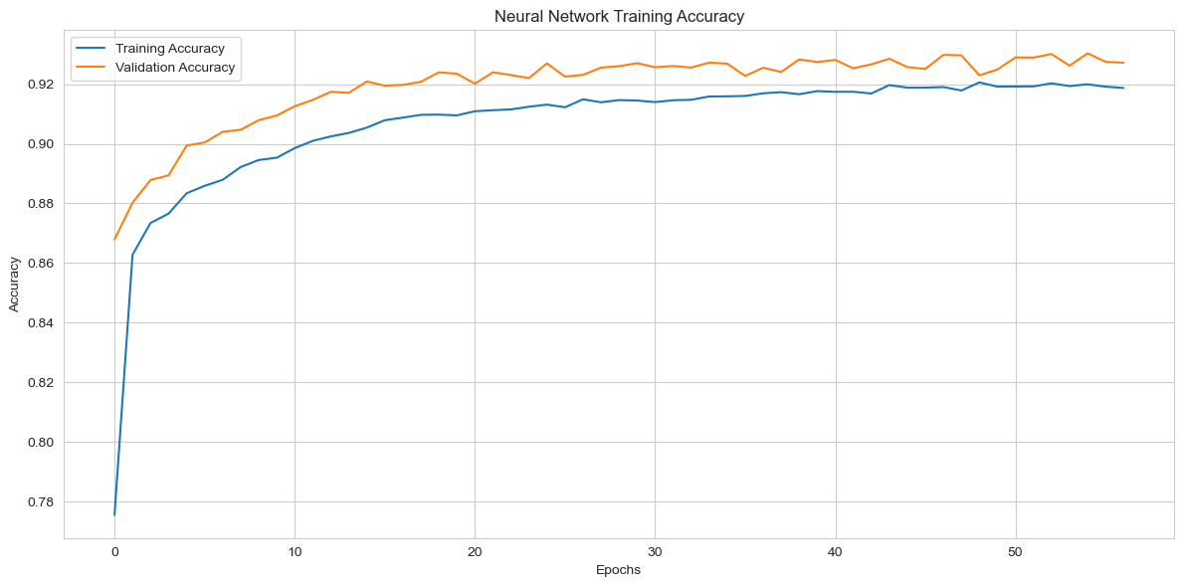

Slide 22
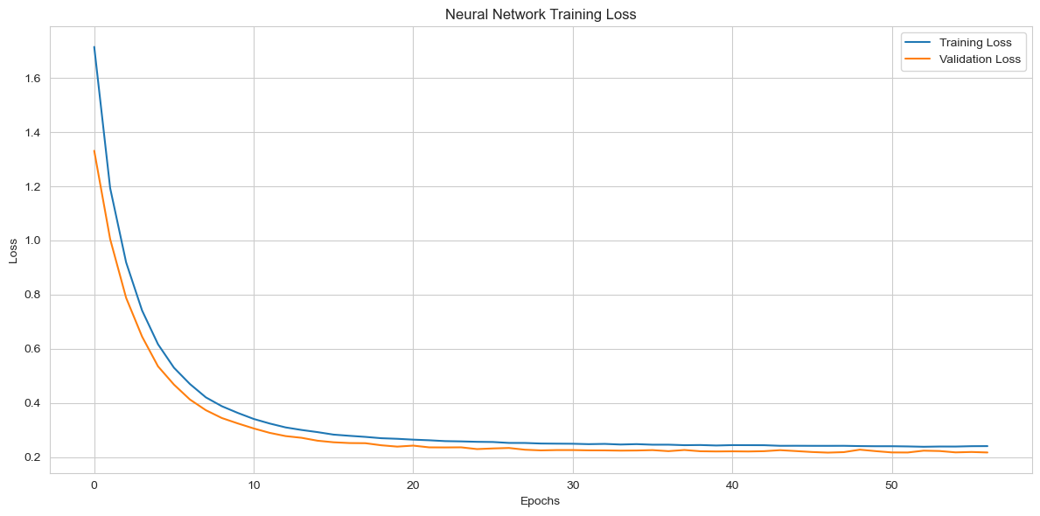

Slide 23
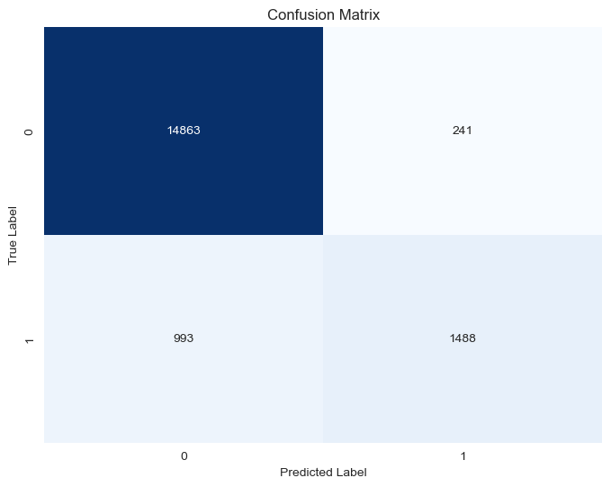
The neural network model achieved an accuracy of 92.98% on the training set and 86.06% on predictions, performing well in predicting rejected loans. However, its recall rate is relatively low, indicating that the model needs improvement in identifying defaulted loans.
By adjusting the classification threshold, balancing the dataset, or adding more features, the model has the potential to improve recall and further optimize its performance.

Slide 24
Gradient Boosting

Slide 25

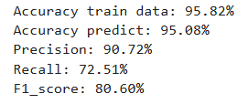
Accuracy:
Train Accuracy: 95.82%, indicating the model fits the training data well.
Prediction Accuracy: 95.08%, demonstrating strong generalization to unseen data.
Precision (90.72%):
High precision means most predicted approvals are accurate, minimizing incorrect approvals (false positives).
Recall (72.51%):
Moderate recall suggests the model misses some eligible approvals, leaving room for improvement in identifying all actual positives.
F1 Score (80.60%):
Balances precision and recall, reflecting good overall performance but highlighting the trade-off between capturing all approvals and ensuring correctness.
The Gradient Boosting Decision Tree with tuned hyperparameters performs excellently overall, with a validation accuracy of 95.10%. Its strengths lie in high precision and accuracy, making it a reliable model for loan approval predictions, though further refinement could enhance recall for a more balanced performance.

Slide 26
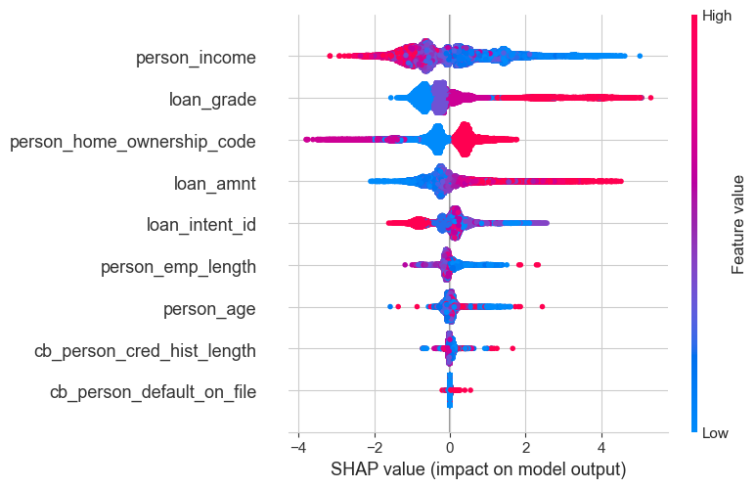
person_income: High-income values (red dots) strongly decrease approval probabilities, while low-income values (blue dots) increase them.
loan_grade: Higher grades (red dots) boost approvals, while lower grades (blue dots) reduce approval likelihood.
person_home_ownership_code: Indicates that owning a home positively impacts approvals.
Features like loan_amnt and loan_intent_id show moderate effects, but their impact is more context-dependent.
Features like cb_person_cred_hist_length have negligible effects overall, as most SHAP values cluster around 0.

Slide 27
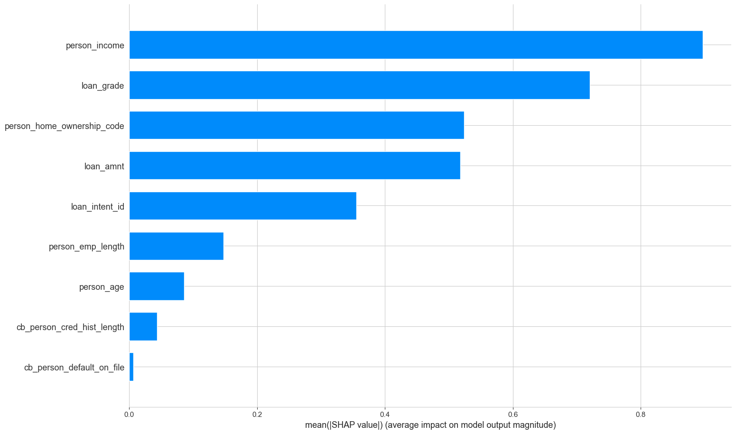
Bar-chart
person_income is the most influential feature, contributing the most to the model's predictions.
loan_grade ranks second, heavily influencing whether loans are approved or not.
Other significant features include person_home_ownership_code and loan_amnt.
Features like cb_person_cred_hist_length and cb_person_default_on_file have minimal impact, suggesting they add little predictive value.

Slide 28
XGBoosting
Enhances GBDT with advanced regularization, sparse data handling, and parallel processing for faster and more accurate models.

Slide 29

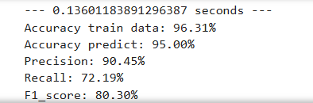
The XGBoost model excels in accuracy and precision, making it highly reliable for predicting approved loans.
Recall (72.19%) remains moderate, suggesting that further focus on capturing all approved loans could enhance the model.
The model strikes a balance between precision and recall, as shown by its F1 Score (80.30%).
The XGBoost model, with optimized parameters, delivers strong accuracy (95.00%) and precision (90.45%), ensuring high confidence in predictions. Its robust performance on validation data highlights generalizability, though moderate recall suggests room for improvement in capturing all eligible approvals.

Slide 30
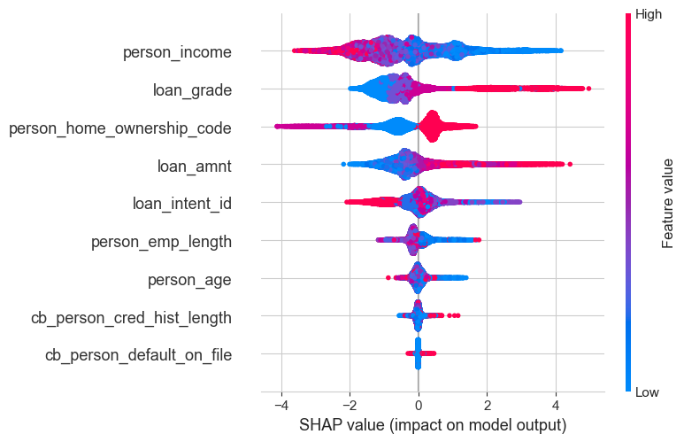
person_income:
High income (red dots) strongly decreases loan approval likelihood.
Low income (blue dots) increases approval probability.
loan_grade:
Higher grades (red) significantly boost approval chances.
Lower grades (blue) reduce approval likelihood.
person_home_ownership_code:
Owning a home (red) positively affects loan approvals.
Other Features:
Features like loan_amnt and loan_intent_id show moderate but consistent effects.
cb_person_cred_hist_length and cb_person_default_on_file have minimal impact as most SHAP values cluster around zero.

Slide 31
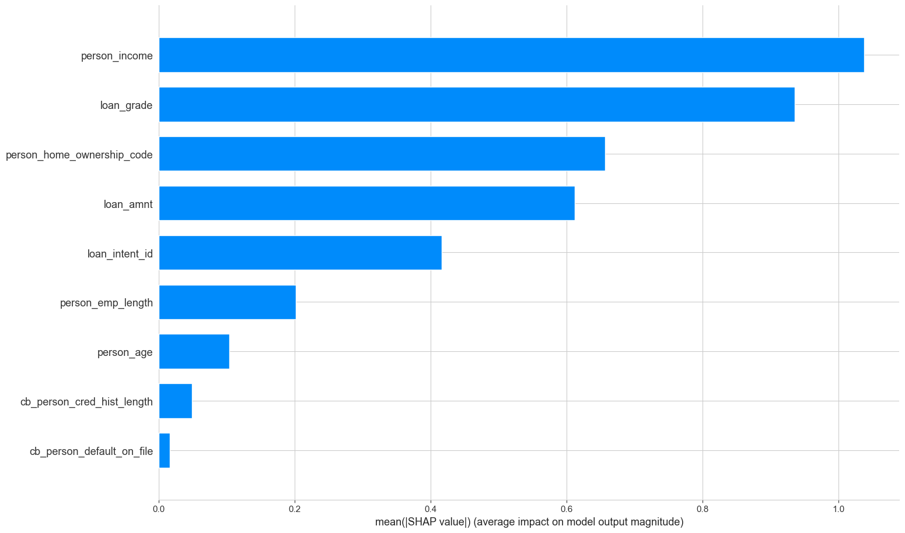
Bar-chart
Top Features:
person_income and loan_grade dominate the model’s predictions, indicating their strong influence.
person_home_ownership_code and loan_amnt are also significant contributors.
Low-Impact Features:
cb_person_cred_hist_length and cb_person_default_on_file contribute minimally, indicating they are less critical for predictions.

Slide 32
LightGBM (bonus)
Focuses on speed and memory efficiency by leveraging histogram-based algorithms and leaf-wise tree growth, making it ideal for large datasets with high dimensionality.

Slide 33

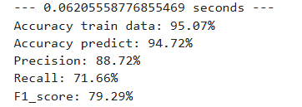
Accuracy:
Train Accuracy: 95.07% shows a well-fitted model without overfitting.
Prediction Accuracy: 94.72%, demonstrating consistent performance on unseen data.
Precision (88.72%):
High precision indicates that most predicted approvals are accurate, minimizing false positives.
Recall (71.66%):
Recall is moderate, indicating some eligible approvals are missed.
F1 Score (79.29%):
Balances precision and recall, reflecting the model's good overall performance.
The LightGBM model delivers strong accuracy (94.72%) and high precision (88.72%), making it reliable for predicting loan approvals. Its quick training time and robust generalization make it an efficient and effective choice for this task, with slight adjustments to improve recall further enhancing performance.

Slide 34
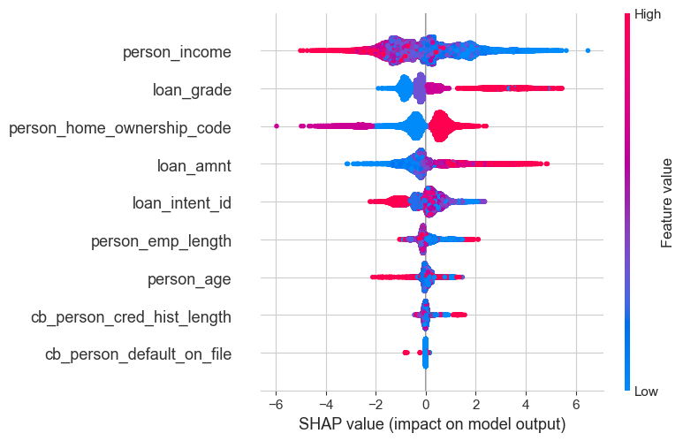
person_income:
High income (red points) strongly decreases loan approval probability, while low income (blue points) increases it significantly. It's the most influential feature.
loan_grade:
Better loan grades (red points) significantly boost approval chances, while lower gradaes (blue points) decrease them.
person_home_ownership_code:
Owning a home positively impacts predictions, suggesting stability as a factor.
Other Features:
Features like loan_amnt and loan_intent_id have moderate impacts.
Variables such as cb_person_cred_hist_length and cb_person_default_on_file contribute minimally, with SHAP values clustering around zero.

Slide 35
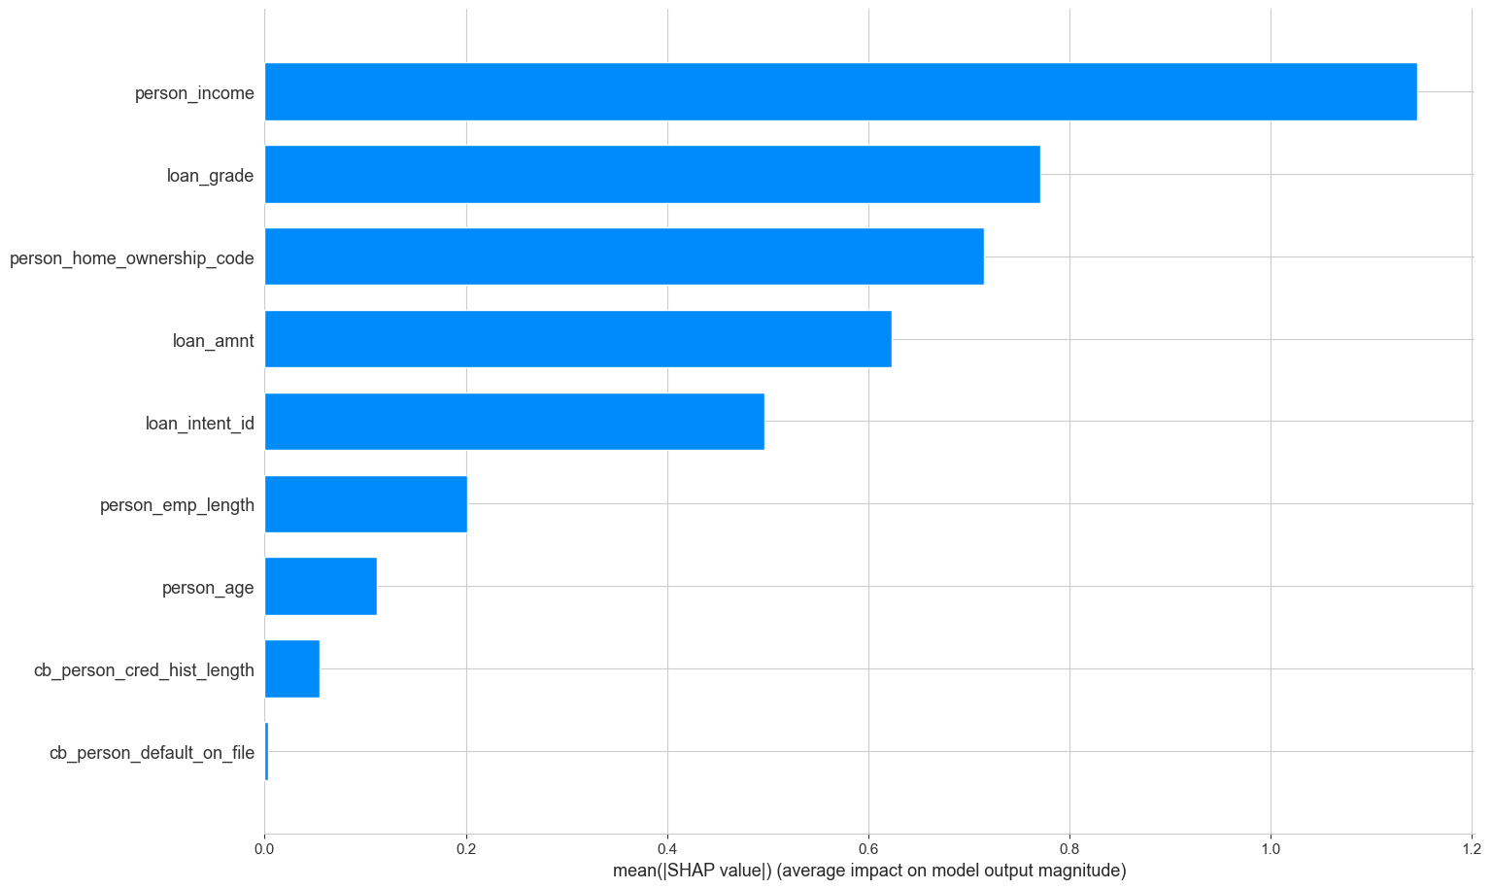
Bar-chart
Top Features:
person_income: The dominant predictor, indicating that income is a key determinant of loan approvals.
loan_grade: A critical factor, reflecting the applicant's creditworthiness.
person_home_ownership_code and loan_amnt: Indicate financial stability and requested loan size, respectively.
Low-Impact Features:
cb_person_cred_hist_length and cb_person_default_on_file have negligible contributions, suggesting limited predictive value.

Slide 36
Summary of the models
Logistic Regression | Train Accuracy - 89.12% | Predict Accuracy - 89.45% | Runtime - 0.88
Decision Tree | Train Accuracy - 94.35% | Predict Accuracy - 94.14% | Runtime - 0.12
Random Forest | Train Accuracy - 92.67% | Predict Accuracy - 93.08% | Runtime - 2.05
Neural Network | Train Accuracy - 92.98% | Predict Accuracy - 86.06% | Runtime - 51.51
Gradient Boosted Decision Tree (GBDT) | Train Accuracy - 95.82% | Predict Accuracy - 95.07% | Runtime - 5.38
XGBoost | Train Accuracy - 96.31% | Predict Accuracy - 95.00% | Runtime - 0.20
LightGB | Train Accuracy - 95.07% | Predict Accuracy - 94.71% | Runtime - 0.08

Slide 37
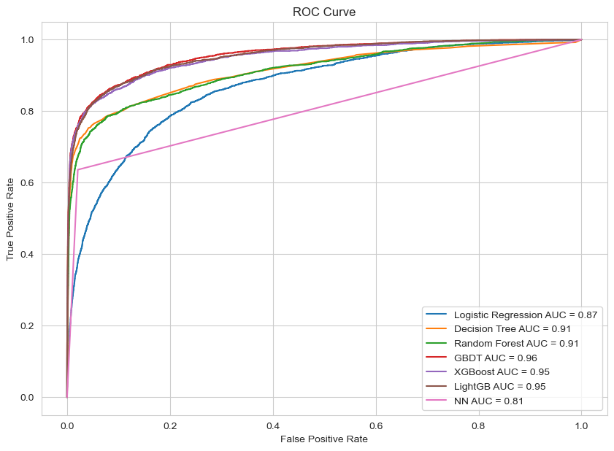

Slide 38
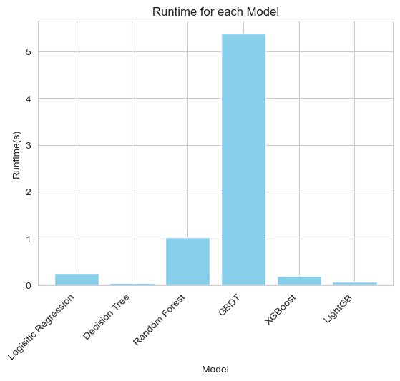

Slide 39
4. Conclusion

Slide 40
Data Overview
Our dataset contains multiple columns such as person_age, person_income, person_home_ownership, person_emp_length, and others.
Data Cleaning
Identified invalid or anomalous data points, such as cases where employment age was calculated to be less than 14 years or applicant age exceeded 100 years. These were dropped to ensure consistency.
Outlier Analysis
Boxplots were created for numeric variables to identify outliers visually (e.g., person_age, person_income, etc.).
Outliers were either analyzed or dropped as appropriate.
Correlation Analysis
We generated a heatmap to show correlations between variables. For example, a high correlation between loan_grade and loan_int_rate, we removed the latter column to avoid multicollinearity.

Slide 41
Visualization
We draw histograms for each numeric variable to understand their distribution, highlighting trends such as income and age distribution.
Model Comparison
Several machine learning models, such as Logistic Regression, Decision Tree, Random Forest, Gradient Boosting Decision Trees (GBDT), XGBoost, and LightGBM, were compared.
Metrics like runtime, training accuracy, and prediction accuracy were evaluated, visualized in bar plots.
XGBoost and GBDT appeared to achieve high prediction accuracy, while LightGBM had a good balance of runtime and accuracy.

Slide 42
Limitation
We need discussion of whether to transform skewed variables (e.g., income or loan amount) or apply scaling to numeric features for better model performance.
Ethical issues such as fairness in loan approval were not discussed.

Slide 43
Future Work
Advanced Data Exploration and Preprocessing
Dive deeper into relationships between variables and address issues like outliers, missing data, and skewness systematically. Utilize appropriate encoding and scaling techniques for better model performance.
Focus on Interpretability and Ethical Considerations
Implement tools to explain our model's predictions and ensure fairness and transparency in decision-making, especially for sensitive domains like finance or healthcare.
Deployment and Scalability
Prepare models for real-world application by automating pipelines, enabling scalability, and setting up monitoring systems to detect and address model drift.

Slide 44
¿ Question ?

Slide 45
♡ Thank You ♡

